Slide 1
COMPUTER SYSTEM AND ORGANISATION
(MODULE 6/6)
BY
Mrs. SUJATA PRADHAN
PGT(SS),AECS,ANUPURAM

Slide 2
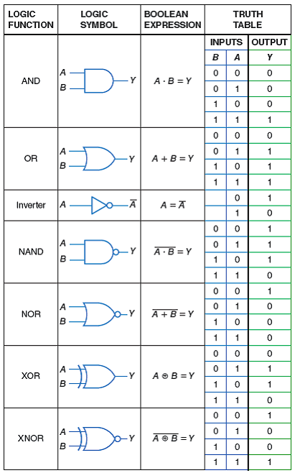
Logic Gates & Truth Tables
Boolean Algebra is the mathematics used to analyse digital gates and circuits.

Slide 3
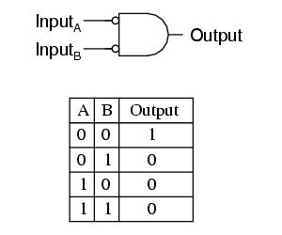
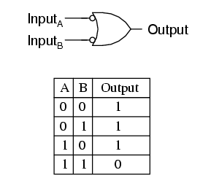
Negative AND & Negative OR gate
A | B | A’ | B’ | A’.B’
0 | 0 | 1 | 1 | 1
0 | 1 | 1 | 0 | 0
1 | 0 | 0 | 1 | 0
1 | 1 | 0 | 0 | 0
A | B | A’ | B’ | A’+B’
0 | 0 | 1 | 1 | 1
0 | 1 | 1 | 0 | 1
1 | 0 | 0 | 1 | 1
1 | 1 | 0 | 0 | 0
A Negative-AND gate, functions the same as an AND gate with all its inputs inverted (connected through NOT gates). A Negative-OR gate , functions the same as an OR gate with all its inputs inverted. Keeping standard gate symbol convention, these inverted inputs are signified by bubbles. So negative AND gate and Negative OR gates are also called as Bubbled AND and Bubbled OR gates respectively.

Slide 4
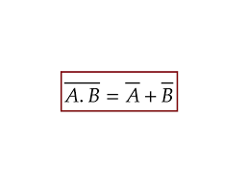


DeMorgan’s First Theorem
According to De Morgan’s theorem, a NAND gate is equivalent to a bubbled OR gate. Therefore, the equation can be written as shown below.
The Boolean expressions for NAND gate is
The Boolean expressions for the bubbled OR gate is
As the NAND and bubbled OR gates are interchangeable, i.e., both gates have exactly identical outputs for the same set of inputs.

Slide 5
Evaluation of DeMorgan’sTheorem using Truth Table
Prove (X.Y)’ = X’+Y’ using truth table.
X | Y | X.Y | (X.Y)’ | X’ | Y’ | X’+Y’
0 | 0 | 0 | 1 | 1 | 1 | 1
0 | 1 | 0 | 1 | 1 | 0 | 1
1 | 0 | 0 | 1 | 0 | 1 | 1
1 | 1 | 1 | 0 | 0 | 0 | 0
From Truth Table it is proved that columns (X.Y)’ = X’+Y’

Slide 6
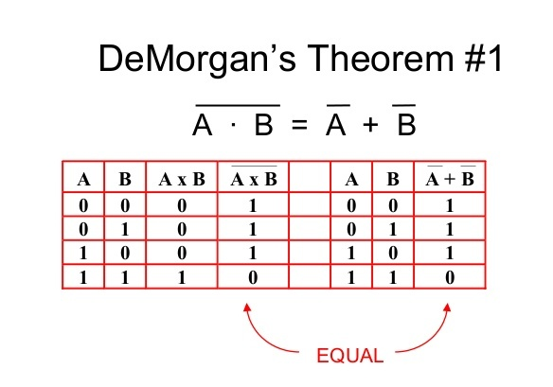
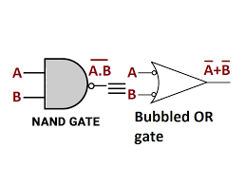
Equality of NAND and Bubbled OR

Slide 7
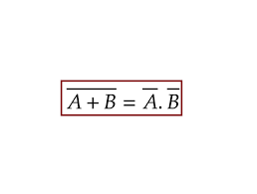


DeMorgan’s Second Theorem
According to DeMorgan’s theorem, a NOR gate is equivalent to a bubbled AND gate. Therefore, the equation can be written as shown below
The Boolean equation for the bubbled AND gate is
The Boolean equation for NOR gate is
As the NOR and bubbled AND gates are interchangeable, i.e., both gates have exactly identical outputs for the same set of inputs.

Slide 8
DeMorgan’sTheorem using Truth Table
Prove (X+Y)’ = X’.Y’ using truth table.
X | Y | X+Y | (X+Y)’ | X’ | Y’ | X’.Y’
0 | 0 | 0 | 1 | 1 | 1 | 1
0 | 1 | 1 | 0 | 1 | 0 | 0
1 | 0 | 1 | 0 | 0 | 1 | 0
1 | 1 | 1 | 0 | 0 | 0 | 0
From Truth Table it is proved that columns (X+Y)’ = X’.Y’

Slide 9
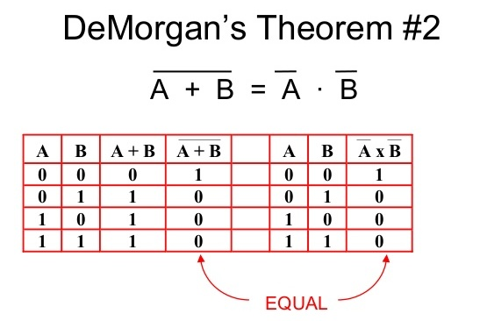
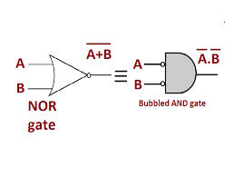
Equality of NOR and Bubbled AND

Slide 10
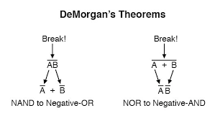
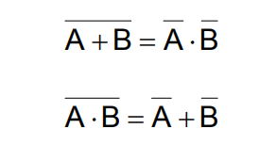
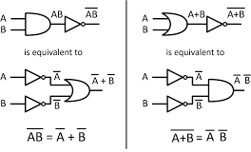
Boolean equations of De Morgan’s Theorem
Note: When a long bar is broken, the operation directly underneath the break changes from logical AND operation to logical OR operation and vice versa.

Slide 11
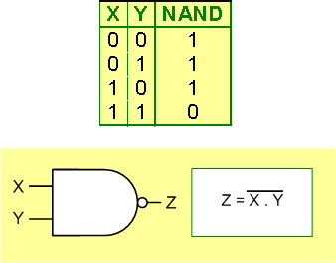
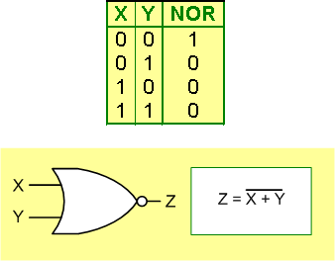
Universal Gates
In addition to AND, OR, and NOT ,fundamental gates, other logic gates like NAND and NOR are also used in the design of digital circuits. A universal gate is a gate which can implement any Boolean function without use of any other gate type. The NAND and NOR gates are universal gates. In practice, this is advantageous since NAND and NOR gates are economical and easier to fabricate all IC digital logic families.
NAND Gate: The NAND gate represents the complement of the AND operation. Its name is an abbreviation of NOT AND. The graphic symbol for the NAND gate consists of an AND symbol with a bubble on the output, denoting that a complement operation is perform.
NOR Gate: The NOR gate represents the complement of the OR operation. Its name is an abbreviation of NOT OR. The graphic symbol for the NOR gate consists of an OR symbol with a bubble on the output, ed on the output of the AND gate.

Slide 12


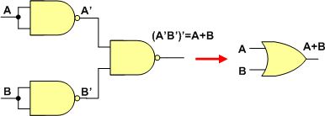
Universality of NAND Gates
1. Implementing an Inverter (NOT gate) using only NAND Gate
All NAND input pins connect to the input signal A gives an output A’.
2. Implementing AND Using only NAND Gates
An AND gate can be replaced by two NAND gates as shown in the figure.
3. Implementing OR Using only NAND Gates
An OR gate can be replaced by three NAND gates as shown in the figure .
Thus, the NAND gate is a universal gate since it can implement the AND, OR and NOT.

Slide 13
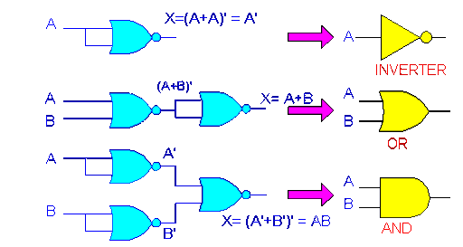
Universality of NOR Gates
Implementing an Inverter Using only NOR Gate: All NOR input pins connect to the input signal A gives an output A’.
Implementing OR Using only NOR Gates: An OR gate can be replaced by NOR gates as shown in the figure (The OR is replaced by a NOR gate with its output complemented by a NOR gate inverter)
Implementing AND Using only NOR Gates: An AND gate can be replaced by NOR gates as shown in the figure (The AND gate is replaced by a NOR gate with all its inputs complemented by NOR gate inverters)
Thus, the NOR gate is a universal gate since it can implement the AND, OR and NOT functions

Slide 14
Boolean Equation of XOR and XNOR Gates
Boolean Equation of XOR
F(A,B)=A’.B+A.B’
Boolean Equation of XNOR
F(A,B)=A.B+A’.B’
Like truth tables,it can be proved algebraically (XOR)’=XNOR
F(A,B)= (A’.B+A.B’)’
=(A’.B)’ . (A.B’)’ (De Morgan’s Theorem)
=((A’)’ + B’) . (A’ + (B’)’) (De Morgan’s Theorem)
=(A + B’) . (A’ + B) ((A’)’=A)
=A.A’ + A.B +B’.A’ + B’.B (A.A’=B.B’=0)
=A.B + A’.B’
Hence proved

Slide 15
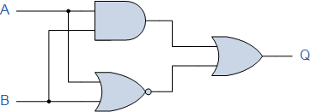
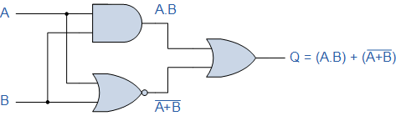
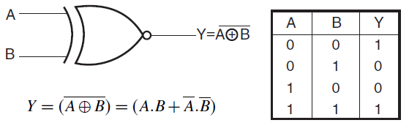
Simplification of Boolean Function
A | B | A.B | A+B | (A+B)’ | A.B+(A+B)’
0 | 0 | 0 | 0 | 1 | 1
0 | 1 | 0 | 1 | 0 | 0
1 | 0 | 0 | 1 | 0 | 0
1 | 1 | 1 | 1 | 0 | 1
Then, the whole circuit above can be replaced by just one single Exclusive-NOR Gate and indeed an Exclusive-NOR Gate is made up of these individual gate functions.
A.B + (A+B)’ = A.B + A’.B’ (Use De Morgan’s Theorem)

Slide 16
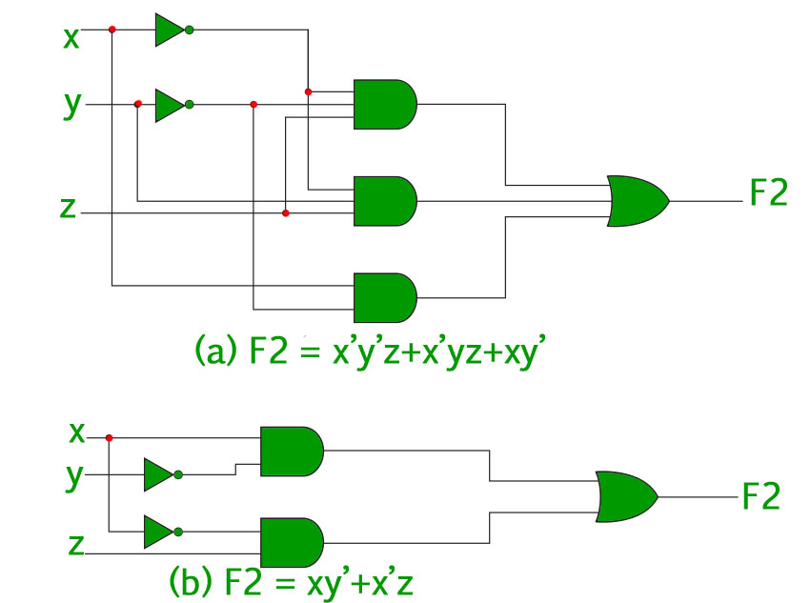
Minimization of Boolean Functions
we need to apply the rules of Boolean algebra to reduce the expression to its simplest form.
Minimized version of the Boolean Expression needs less number of logic gates and also reduces the complexity of the circuit substantially. Hence minimization is important to find the most economic equivalent representation of a boolean function. The component reduction results in higher operating speed, less power consumption, less cost, and greater reliability.
Example:
F(X,Y,Z) = X’ Y’ Z + X’ Y Z + X Y’
= X’ Z ( Y’ + Y ) + X Y’
= X’ Z + X Y’ (Y’ + Y = 1)
= X Y’ + X’ Z

Slide 17
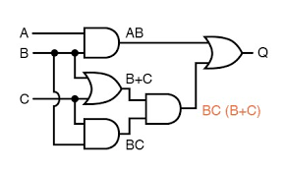
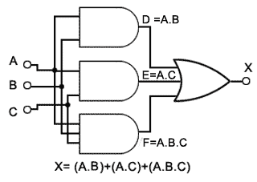
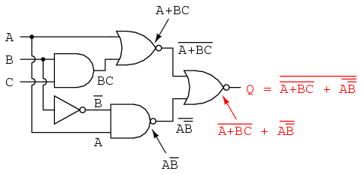
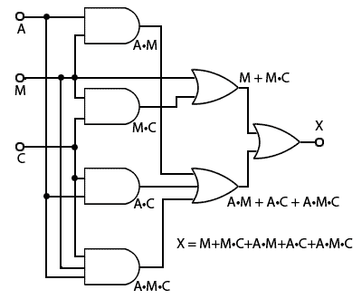
Boolean equation from a Circuit

Slide 18
Laws of Boolean Algebra
Boolean laws can be used to prove any given Boolean expression as well as for simplifying complicated digital circuits.
Commutative Law | A . B = B . A | A + B = B + A
Associative Law | A . (B . C) = (A . B) . C | A . (B . C) = (A . B) . C
Distributive Law | A + BC = (A + B) (A + C) | A . (B+C) = A . B + A . C
Annulment law: | A.0 = 0 | A + 1 = 1
Identity law: | A.1 = A | A + 0 = A
Idempotent law: | A + A = A | A . A = A
Complement law: | A + A' = 1 | A . A'= 0
Double negation law: | (A)')' = A
Absorption law: | A.(A+B) = A | A + AB = A
De Morgan’s Theorem | (A + B)’ = A’ . B’ | (A . B)’ = A’ + B’

Slide 19
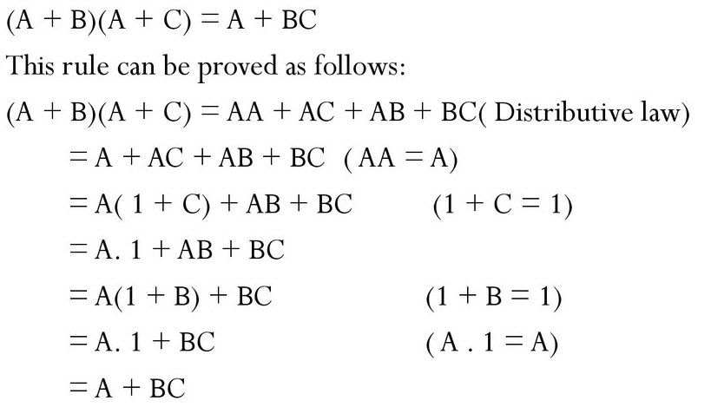
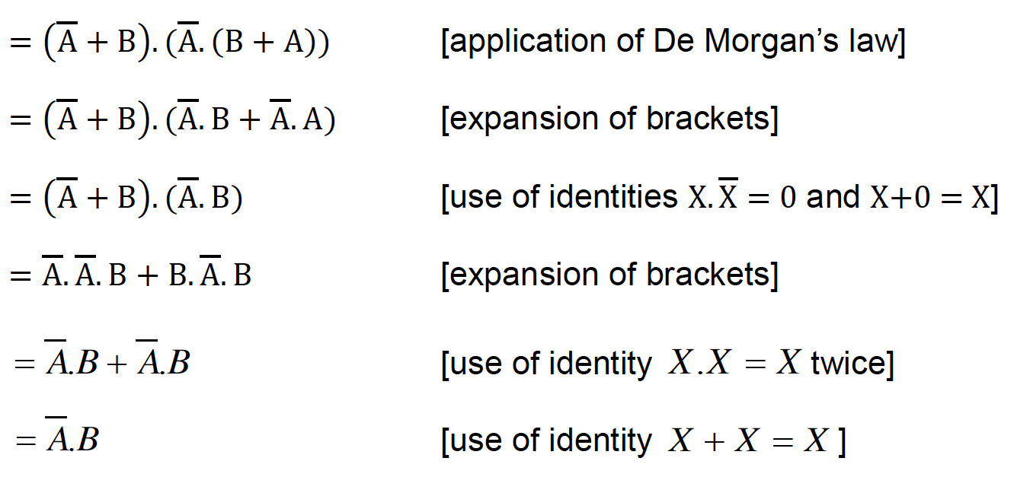
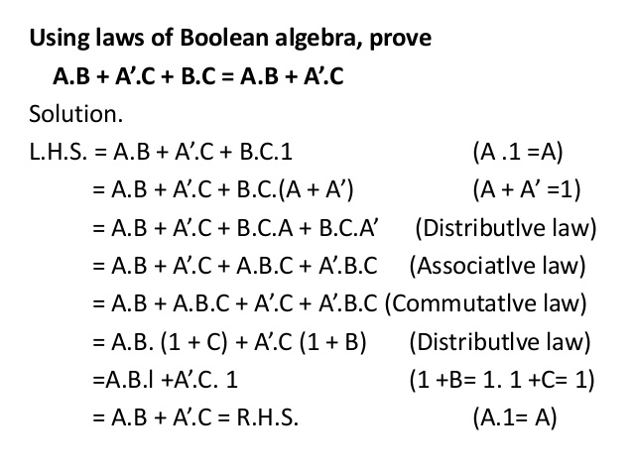
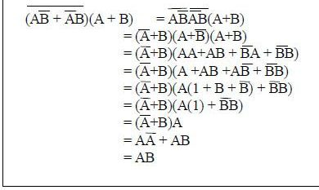
Simplification of Boolean Expressions

Slide 20
SUMMARY
De Morgan’s Theorem
Negative AND & Negative OR Gates
Universality of NAND and NOR Gates
Boolean Equation from a circuit
Simplification of Boolean Functions

Slide 21
THANK YOU

